Slide 1
Joystick-Controlled 2-DOF Robotic Arm
Arduino-Based Project Presentation
January 2026

Slide 2
What is a Robotic Arm?

Slide 3
Definition & Basics
A robotic arm is a programmable mechanical arm that mimics the functions of a human arm.
Used in industry for precision tasks (welding, assembly, picking).
In education/hobby projects: Built with servo motors for controlled movement.
Degrees of Freedom (DOF): Number of independent movements.
  This project: 2 DOF (Base rotation + Arm lift)

Slide 4
Project Inspiration

Slide 5
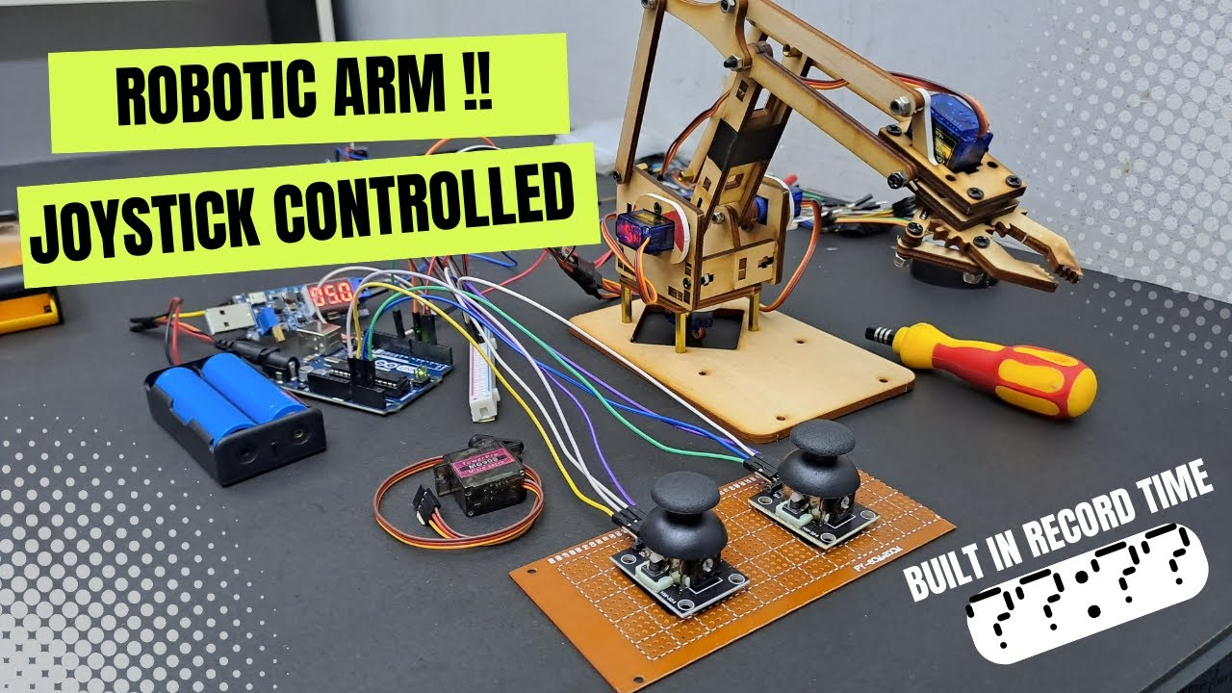
Real-World Examples
Joystick-controlled robotic arms in action

Slide 6
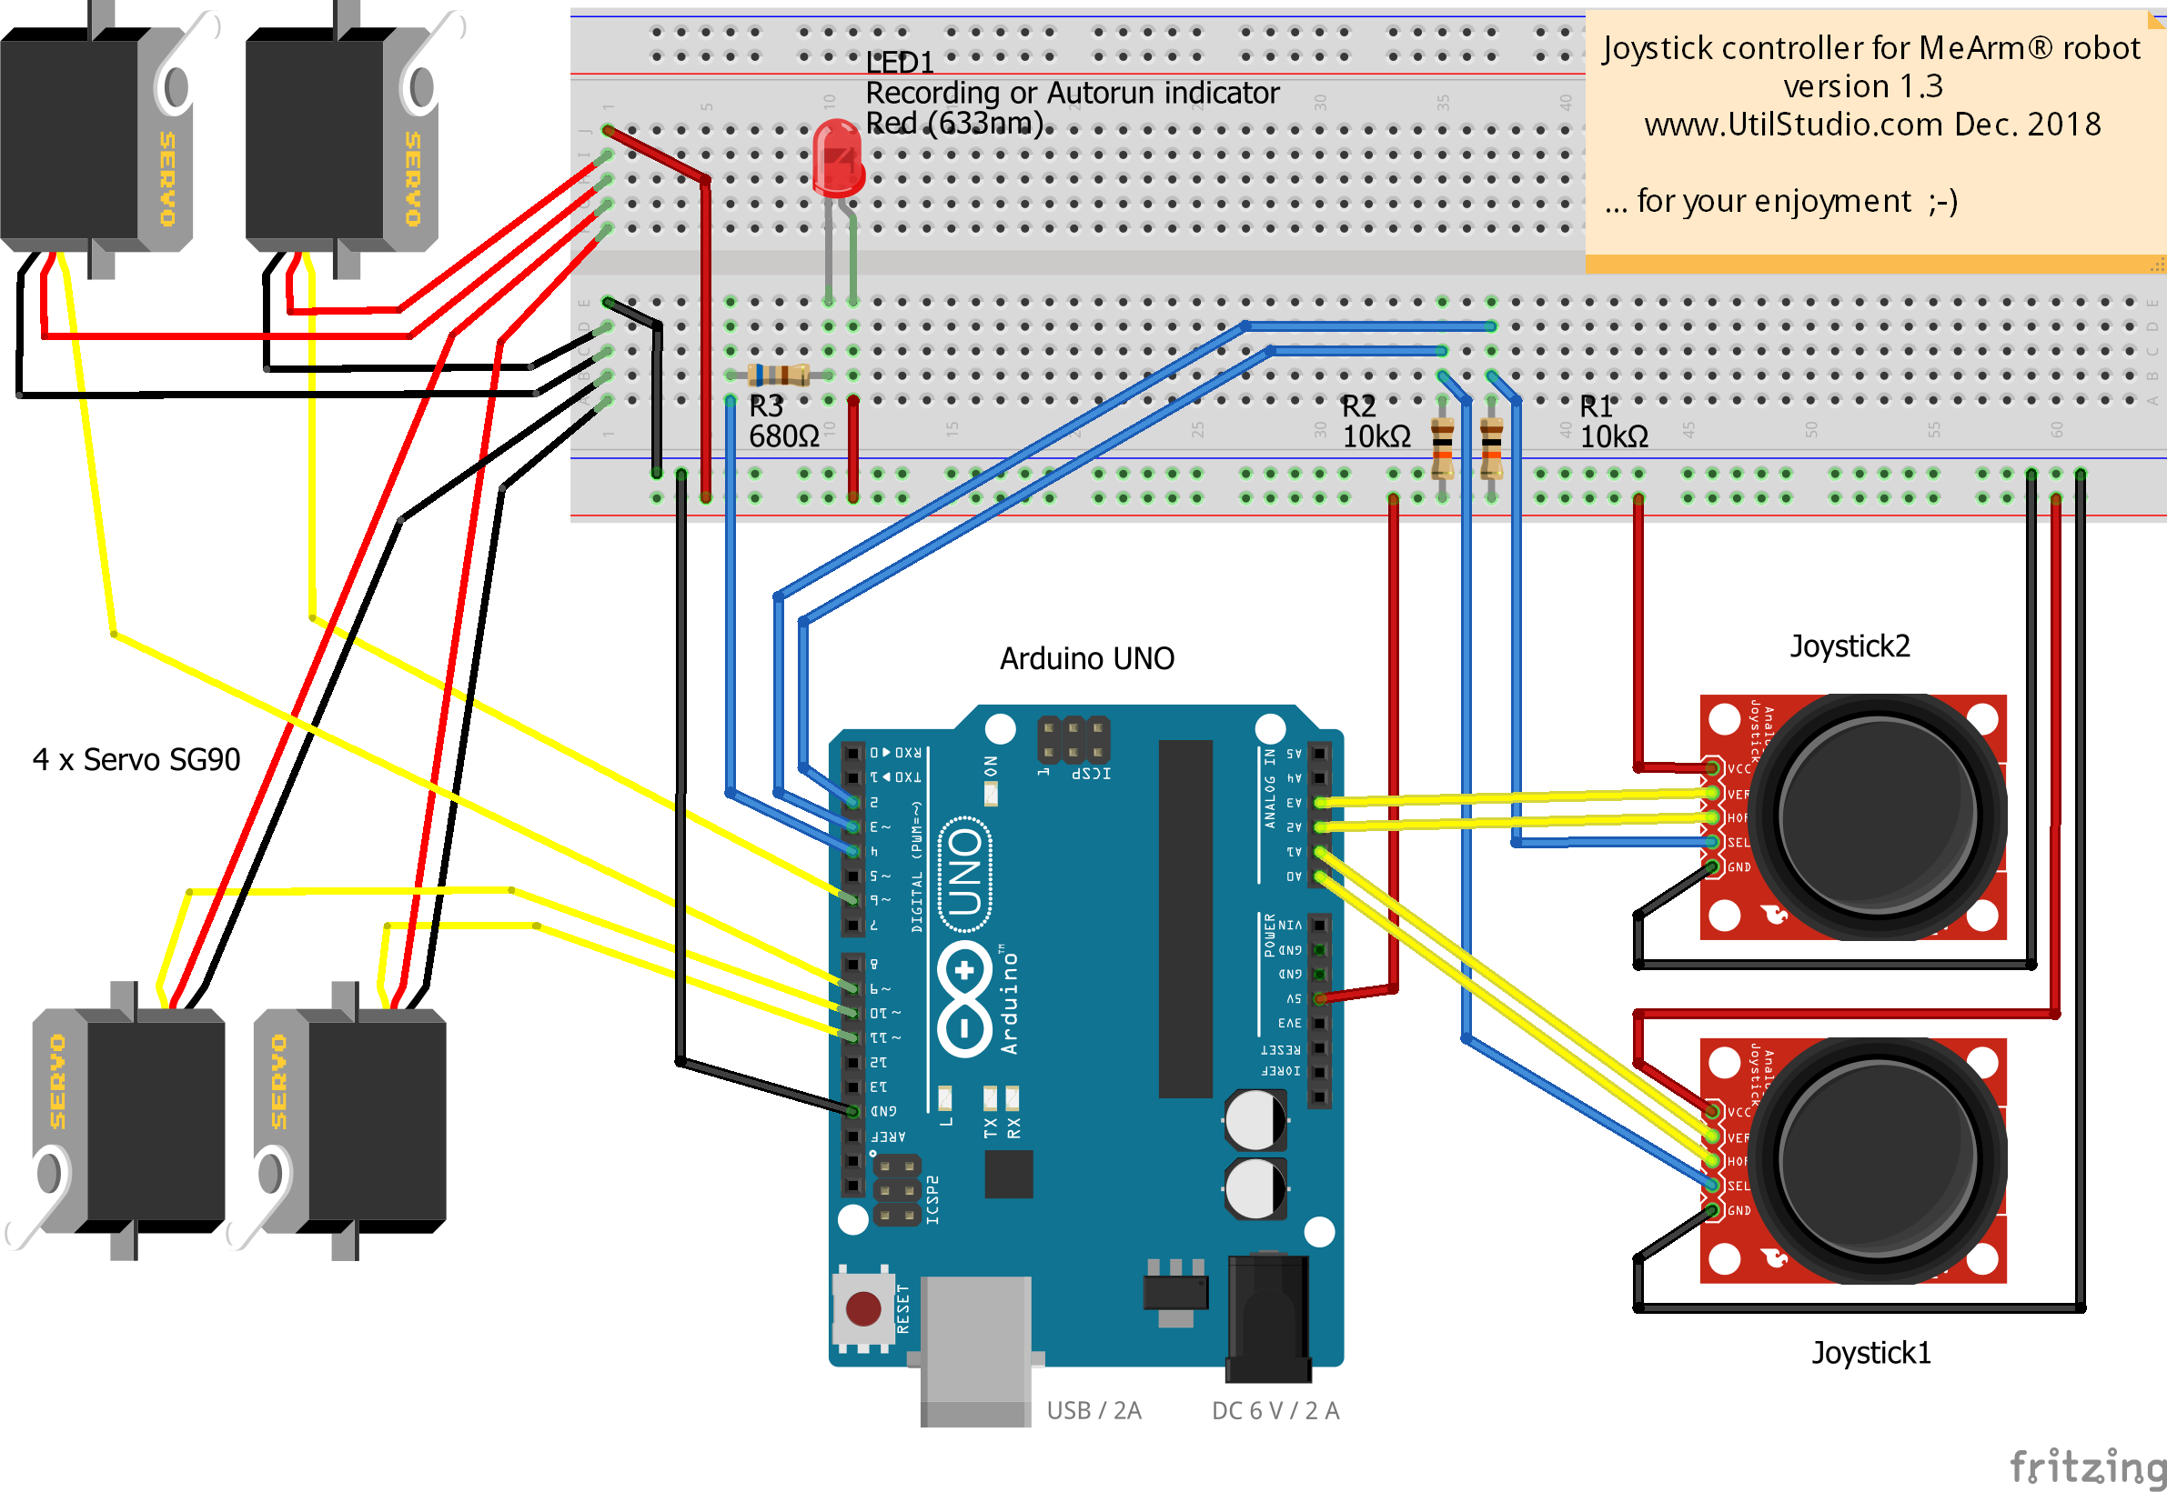
Similar Projects
MeArm-style joystick control

Slide 7
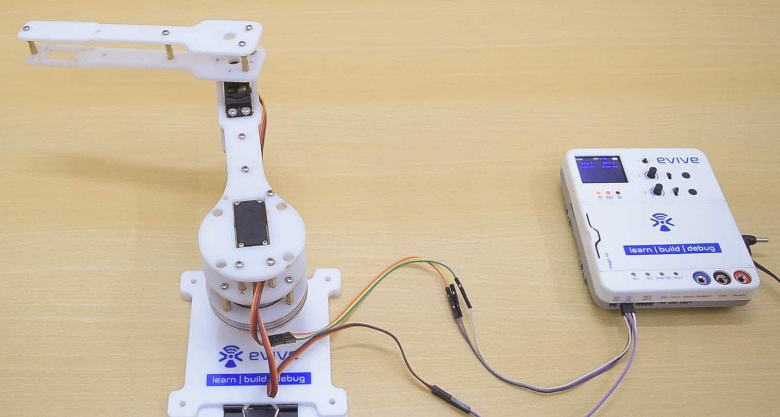
Simple 2-DOF Designs
Basic servo-based arm

Slide 8
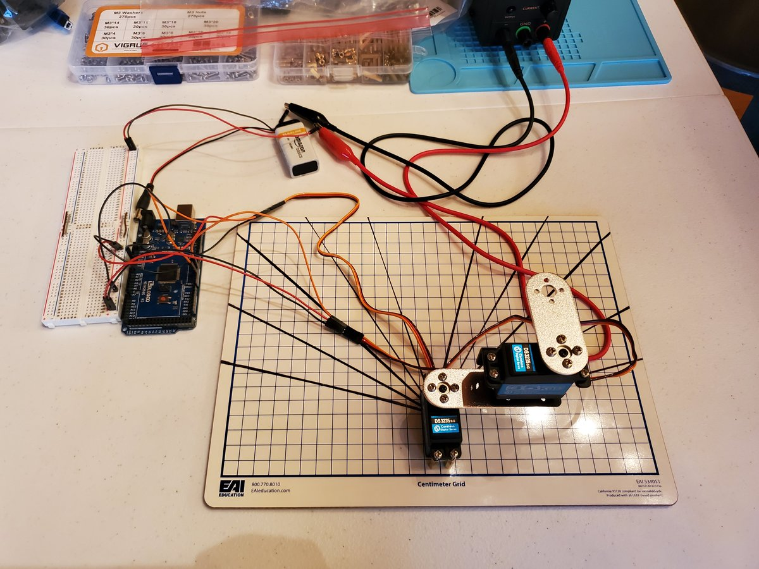
Professional 2-DOF build guide

Slide 9
Components Used

Slide 10
Key Hardware
Arduino Uno/Nano
2 × Hobby Servo Motors (e.g., SG90/MG90S)
  Base servo (low load)
  Arm servo (higher load - 'hanged')
Analog Joystick Module (XY axes)
Breadboard & Jumper Wires
External Power: 2× 3.7V batteries (~7.4V) or 4× AA
Optional: Capacitor for power stability

Slide 11
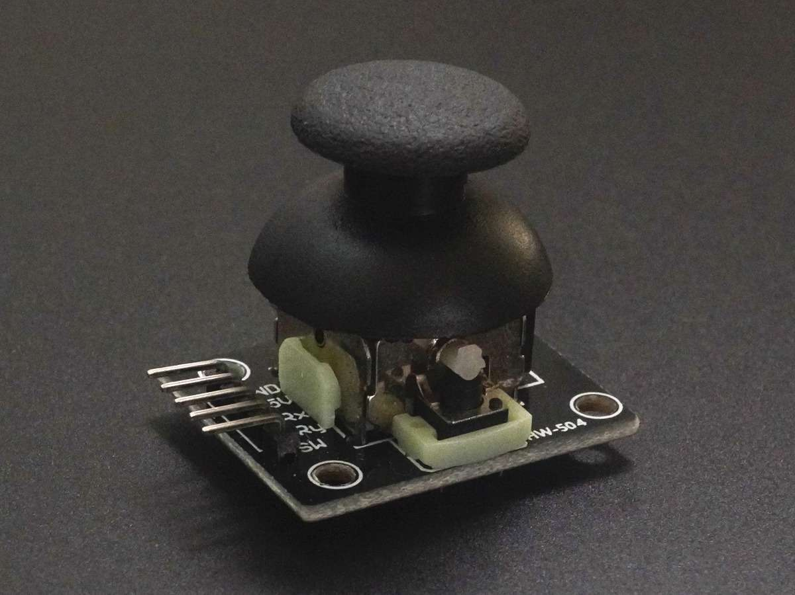
Joystick Module
Dual-axis analog joystick

Slide 12
Wiring & Power

Slide 13
Connections
Joystick: GND → GND, +5V → 5V, VRx → A0, VRy → A1
Servos: Signal → Pins 3 & 5
  Power (red) → External battery +
  Ground → External battery - + Arduino GND (common ground!)
Critical: External power prevents lag under load

Slide 14
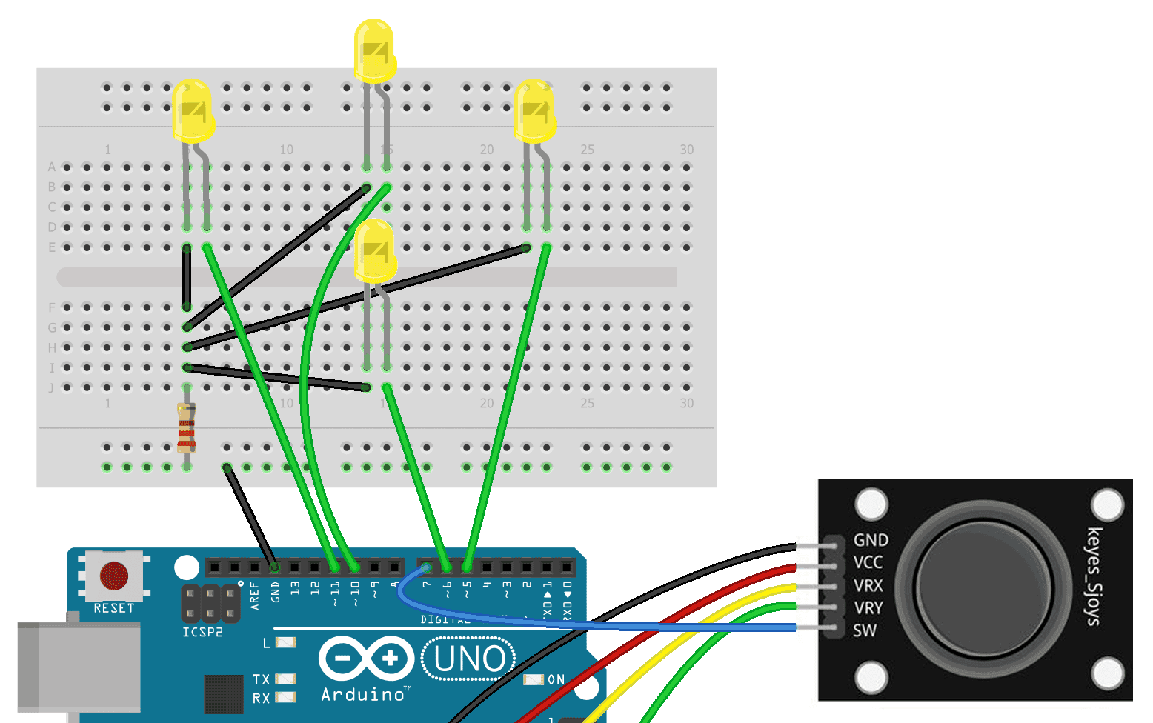
Wiring Diagram
Joystick & Arduino connections

Slide 15
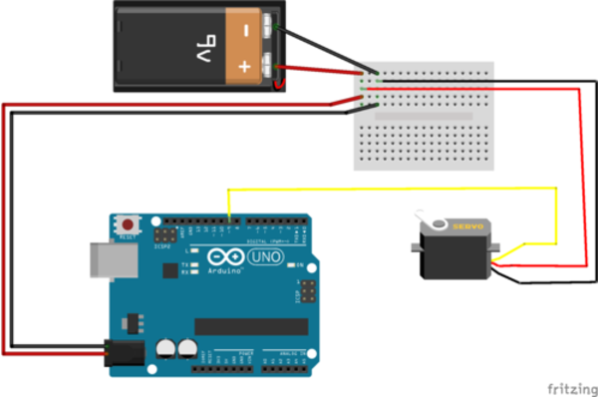
External Power Setup
Safe servo powering with common ground

Slide 16
Arduino Code

Slide 17
Complete Code
#include <Servo.h>
Servo servoBase; // Base
Servo servoArm; // Arm
int joyX = A0;
int joyY = A1;
int currentPosBase = 90;
int currentPosArm = 90;
void setup() {
servoBase.attach(3);
servoArm.attach(5);
servoBase.write(90);
servoArm.write(90);
}
void loop() {
int targetBase = map(analogRead(joyX), 0, 1023, 0, 180);
int targetArm = map(analogRead(joyY), 0, 1023, 0, 180);
// Smooth incremental movement
if (currentPosBase < targetBase) currentPosBase++;
else if (currentPosBase > targetBase) currentPosBase--;
if (currentPosArm < targetArm) currentPosArm++;
else if (currentPosArm > targetArm) currentPosArm--;
servoBase.write(currentPosBase);
servoArm.write(currentPosArm);
delay(15);
}

Slide 18
How It Works & Troubleshooting

Slide 19
Operation
Joystick → Analog values (0-1023)
Mapped to 0-180° servo angles
Incremental steps (±1°) for smooth motion
External power solves lag on loaded servo

Slide 20
Lessons Learned
Issue: Arm servo laggy → USB power insufficient
Fix: External batteries + common ground
Tip: Always separate power for loaded servos

Slide 21
Thank You!
Project Complete & Fully Functional
Ready for expansions (gripper, more DOF)
Questions?

